Slide 1

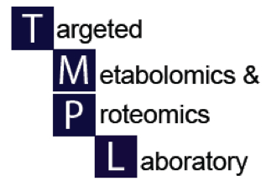

Imaging metabolomics
UAB Metabolomics Workshop
December 2, 2015
Janusz H. Kabarowski, PhD

Slide 2
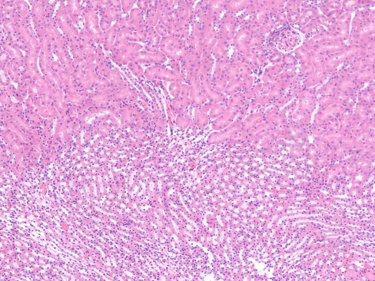
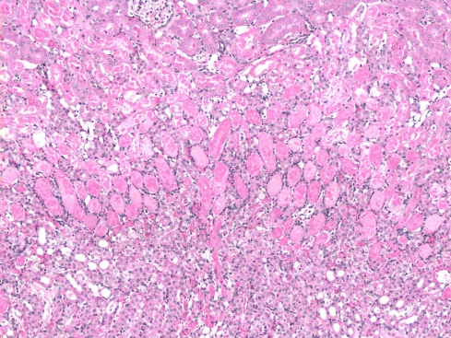
MALDI-IMS for Spatial Analysis of Metabolites in acute kidney injury
H₃C
CH₃
C
CH₃
CH₃
CH₃
HO
H₃C
CH₃
C
OH
O
CH₃
CH₃
CH₃
NH₂
O
HO
O
P
HO
O
HO
OH
OH
OH
HO
OH
H
O
CH₃
HO
O
O
P
O
N
CH₃
O
OH
CH₃
O
O
HO
O
H
O
CH₃
HO
O
O
P
O
N
CH₃
O
OH
CH₃
Janusz Kabarowski, Dept. Microbiology, UAB.

Slide 3
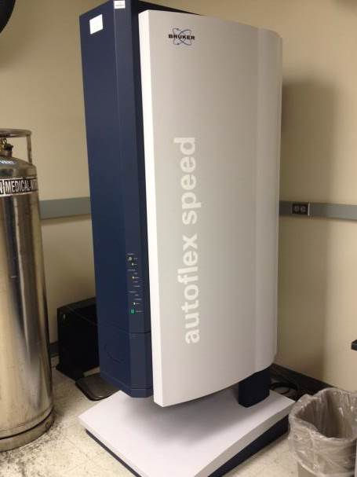
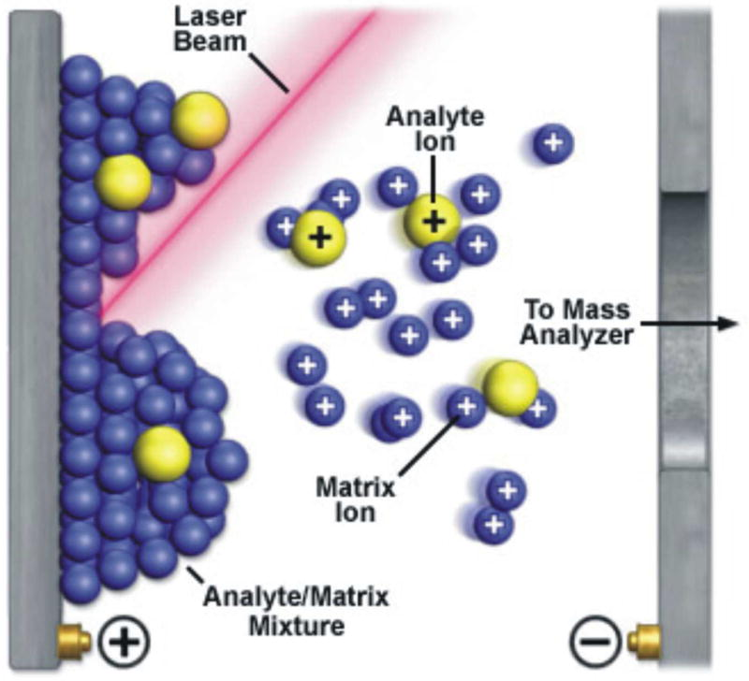
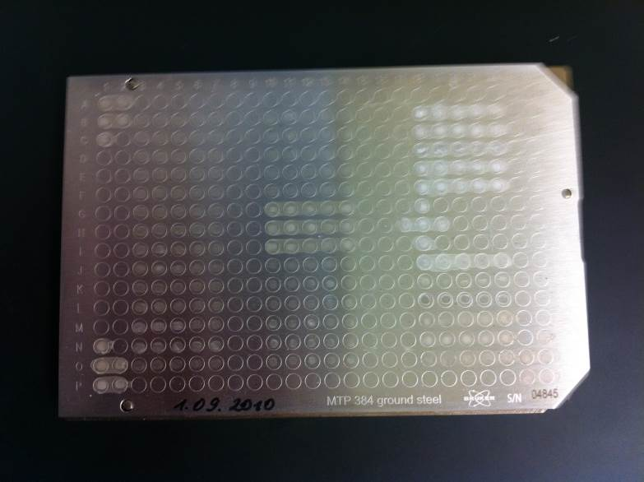
Matrix-Assisted Laser Desorption/Ionization (MALDI):
Matrix molecules absorb laser light, enter an excited state, and collide with sample molecules, facilitating charge transfer to create ions.
Conventional MALDI plate
MALDI-TOF
instrument
Mass Spectrometric Imaging for biomedical tissue analysis
Kamila Chughtai and Ron M.A. Heeren
Chem Rev. Vol.110(5): pp3237–3277, 2010.

Slide 4
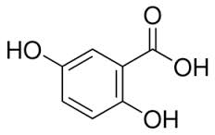
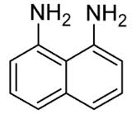
Vacuum sublimation
Used to apply an even microscopically thin uniform layer of matrix compound onto tissue section
without the need for solvents
Sublimation: the transition of a substance from solid to
gas phase without an intermediate liquid phase.
MALDI matrices for lipid imaging:
DHB: 2,5-dihydrobenzoic acid (+ve mode)
1,5-diaminonapthalene (-ve mode)
Notes:
The role of the matrix is to absorb the majority of the laser energy leading to explosive desorption of the matrix crystals together with incorporated analyte into the gas phase without degradation of the analyte. The matrix also aids the ionization of analyte molecules in the gas phase due to the presence of protons from added acids such as trifluoroacetic acid (TFA).

Slide 5
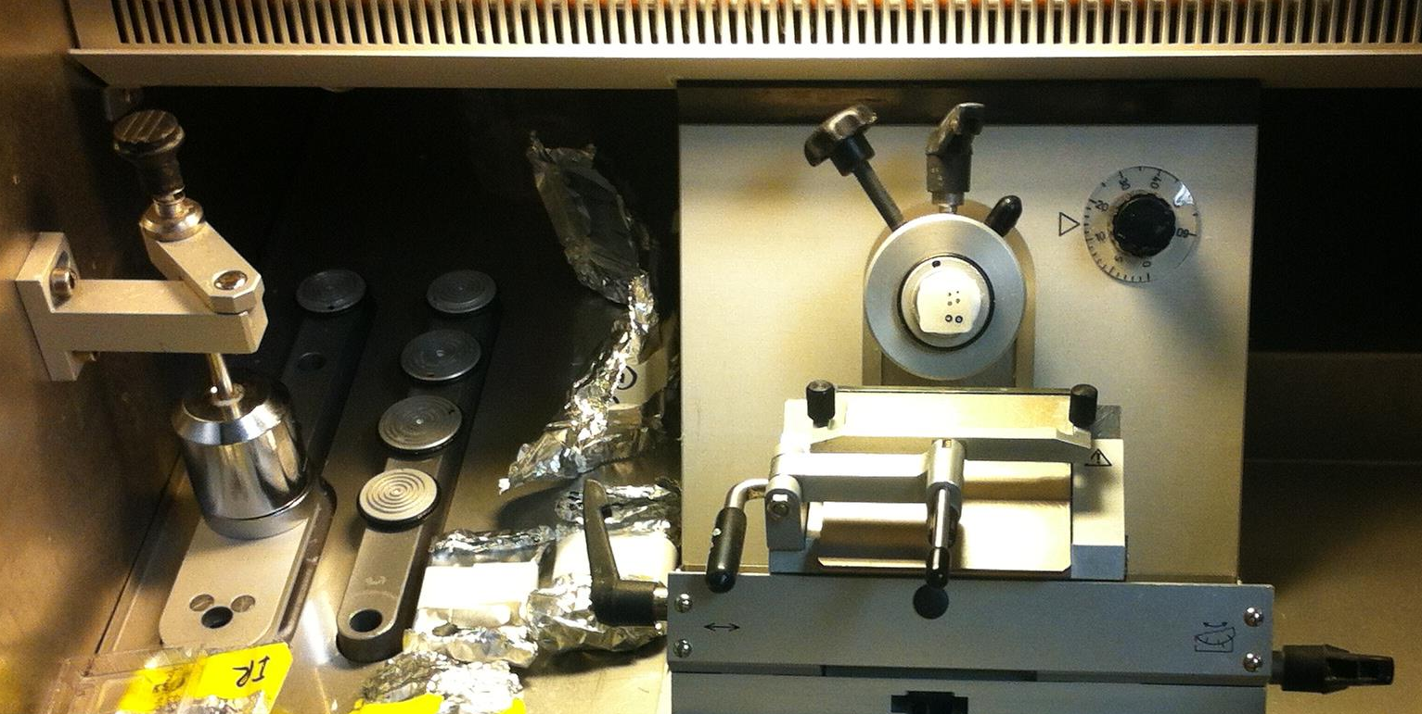
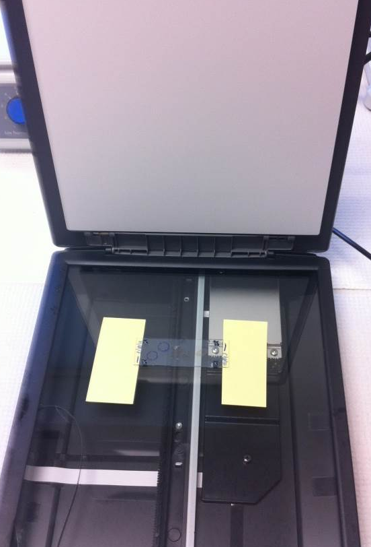
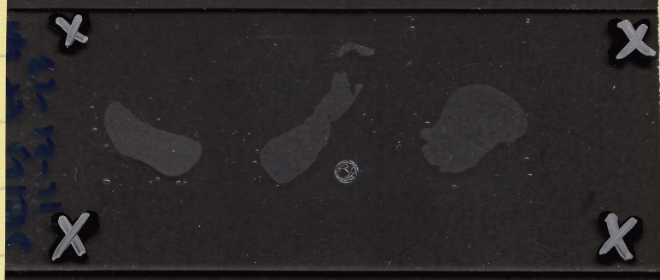
Cryosectioning onto Indium Tin Oxide (ITO) coated glass slides and scanning digital image of slide for “teaching” FlexControl software on MALDI-TOF.
Cryosectioning10% gelatin
embedded tissue block
Minimum 2400dpi
cryosection image
Matrix
application
Notes:
OCT and other common histological embedding media ionize easily during MS analysis and cause ion suppression. ITO = indium tin oxide…conductive (must be conductive otherwise electrostatic charges will occur).

Slide 6
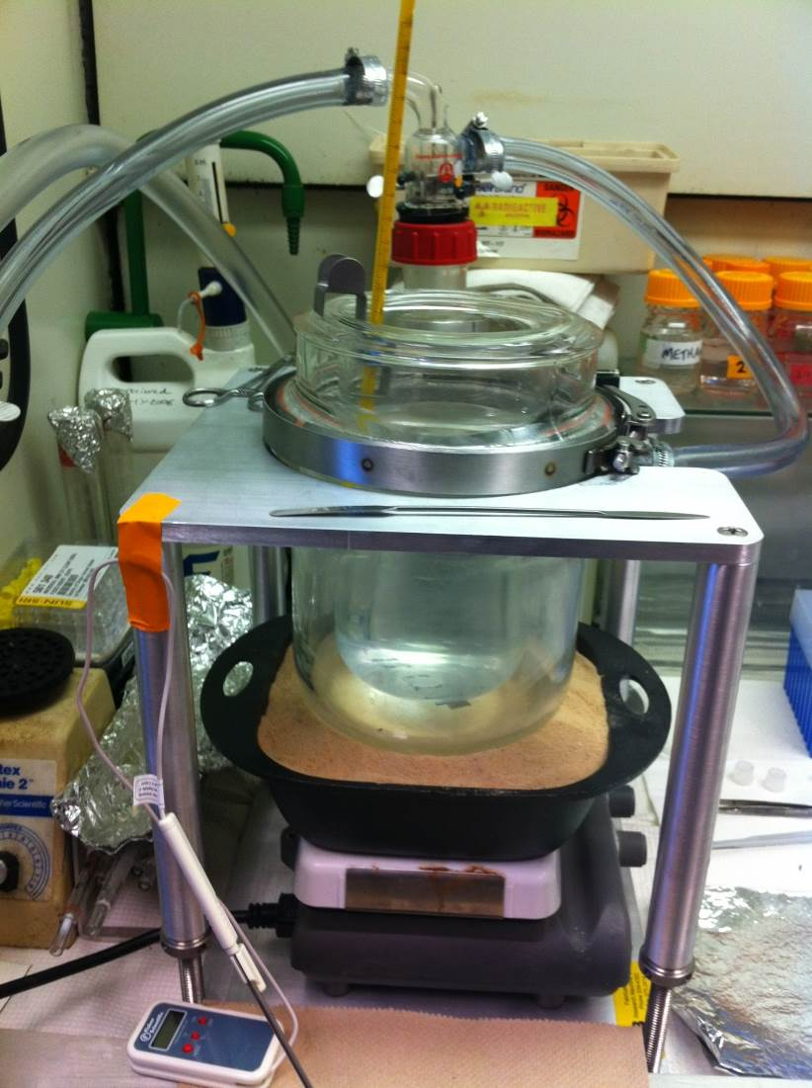
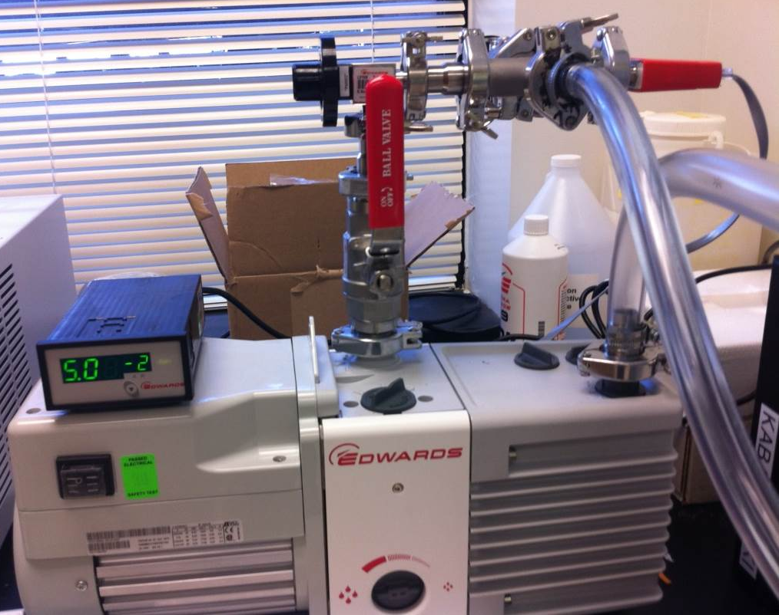
How do we apply matrix for MALDI Imaging?
We built a vacuum sublimation apparatus.
Vacuum
micro-valves
Digital vacuum
monitor
Pirani vacuum
gauge
Vacuum
sublimation
chamber
vacuum
exhaust
Heated sand bath
Notes:
The Pirani gauge is a thermal conductivity gauge used to measure pressure in vacuum systems. It consists of a metal filament (usually platinum) suspended in a tube which is connected to the vacuum system. A heated metal filament suspended in a gas will lose heat to the gas as its molecules collide with the filament and remove heat…..if the gas pressure is reduced, the number of molecules will fall proportionately and so the filament will lose heat more slowly (measuring the heat loss is thus an indirect measure of pressure).

Slide 7
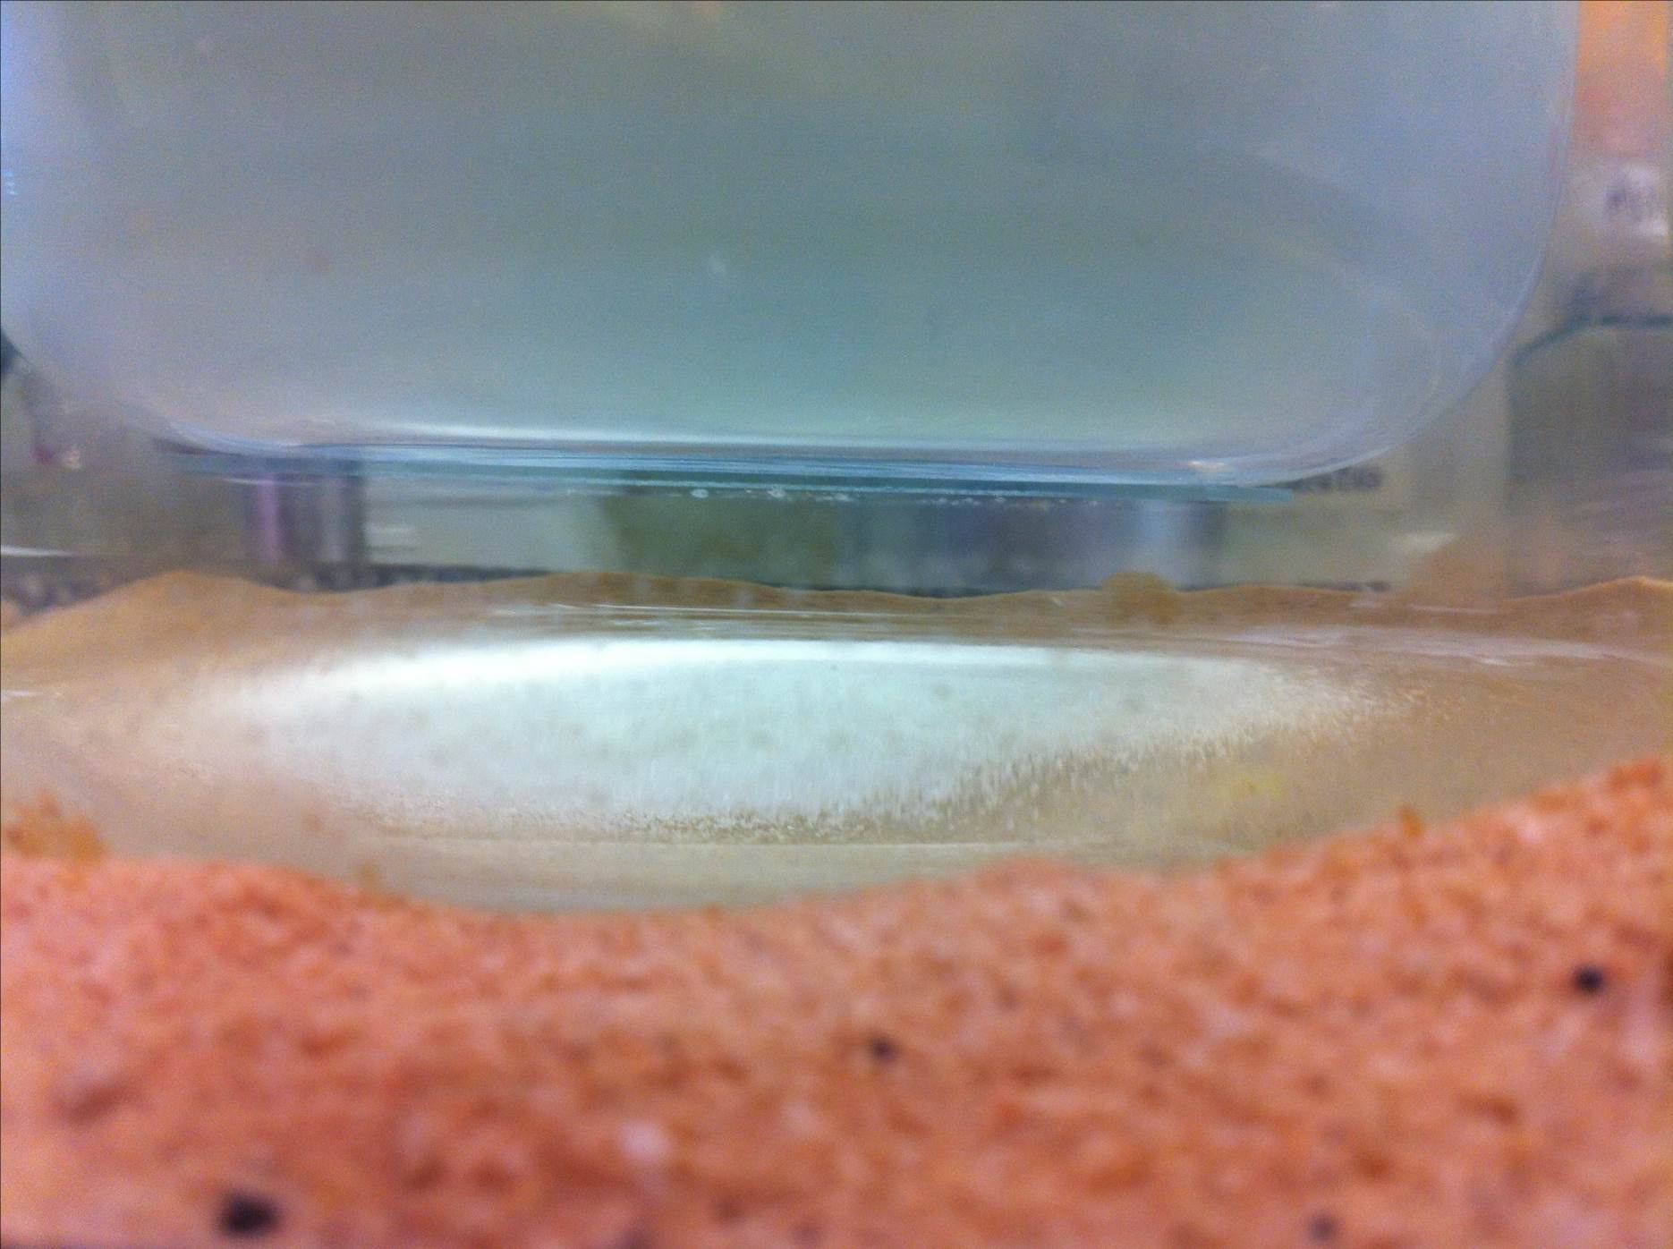
Matrix deposition by vacuum sublimation
Cold condensor unit
of vacuum
sublimation chamber
5-10°C
0.05 Torr
ITO (indium-tin-oxide coated)
slide with cryosections
Matrix
compound
140°C
Heated sand

Slide 8
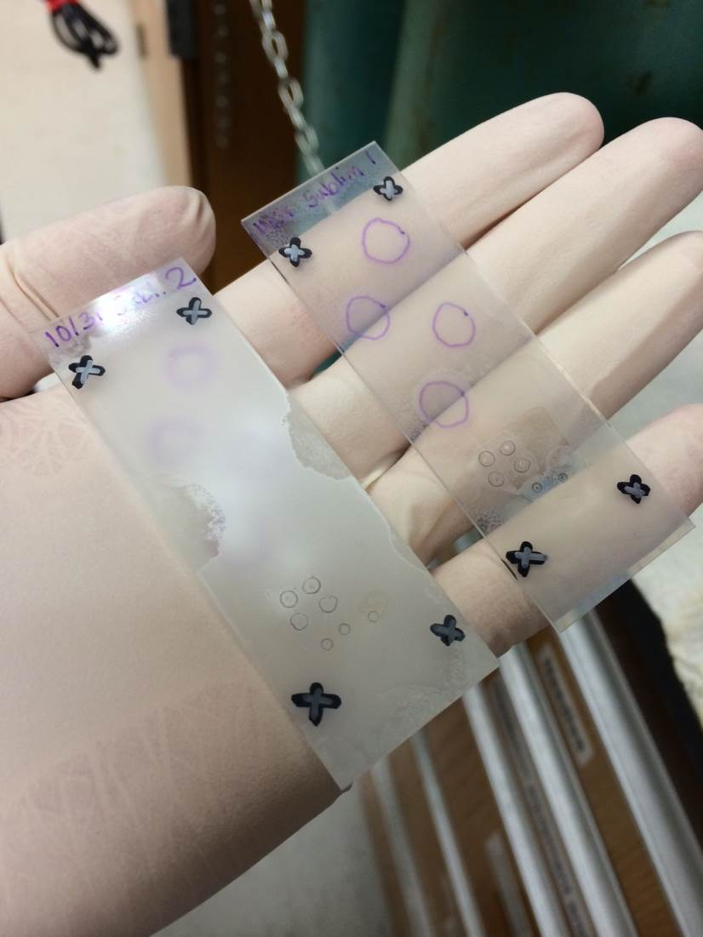
Slides with matrix applied by vacuum sublimation
Deposition of the matrix compound is at the molecular level because gaseous molecules recrystallize at the relatively cold surface of the tissue section attached to the cold condenser.
The uniformity of matrix deposition onto the slide attached to the cold condenser surface reflects the random Brownian motion of the released gaseous matrix molecules.

Slide 9
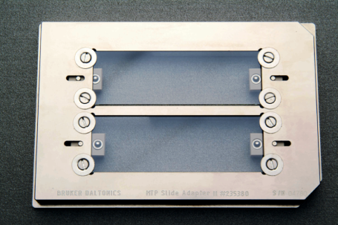
Adapted MALDI plate holds slides for
MALDI-imaging MS
Conventional MALDI plate
MALDI plate for cryosections

Slide 10
Quantitative and Spatial
Analysis of Lipids Involved in
Acute Kidney Injury

Slide 11
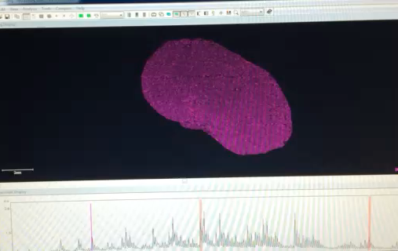

Slide 12
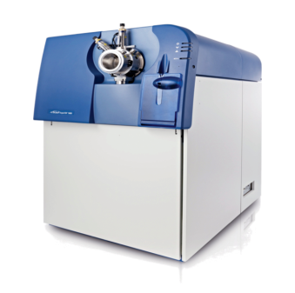
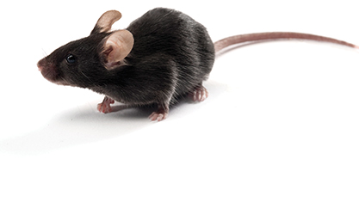
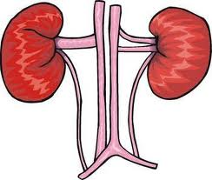
8-10 weeks
old C57Bl6/J
SWATH (MS/MS^{ALL}) on 5600 Triple-TOF Mass Spectrometer
Normalized
kidney weight
Sham surgery or IR
10% gelatin
cryosections
Nephrectomy
MALDI-Imaging MS on a Bruker-TOF Mass Spectrometer
SWATH (Sequential Window Acquisition of all Theoretical Mass Spectra
Notes:
AB-SCIEX 5600 TripleTOF mass spectrometer. This machine, equipped with data-independent Sequential Window Acquisition of all Theoretical mass spectra (SWATH), generates a comprehensive archive of lipids within an extract for retrospective, quantitative analysis. This technology offers several strengths for delineating unknown pathways.

Slide 13
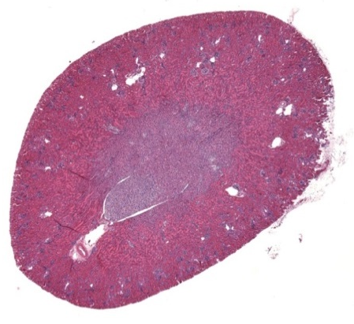
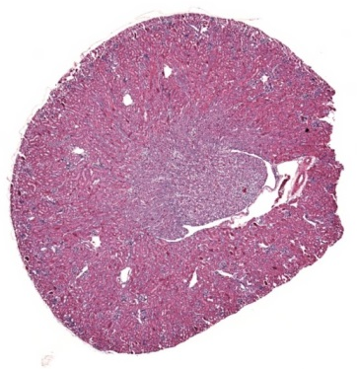
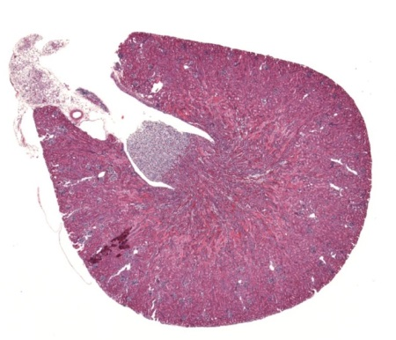
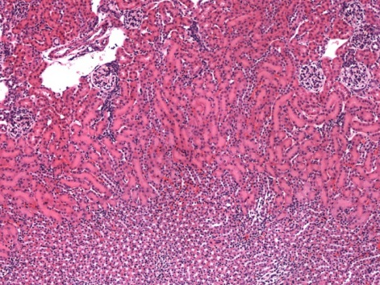
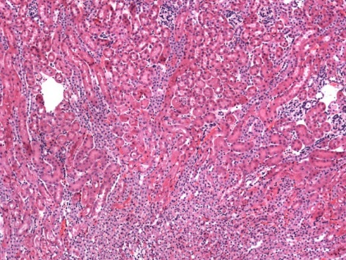
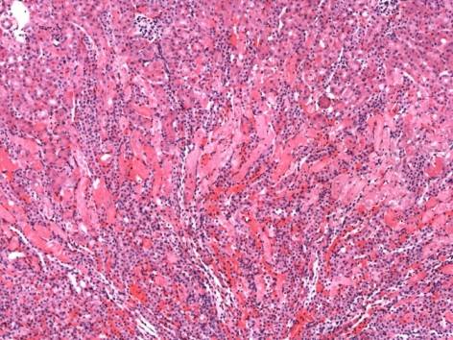
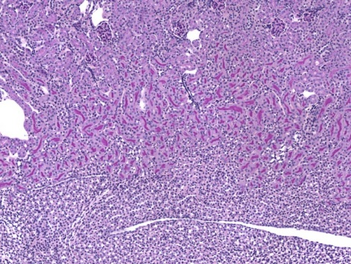
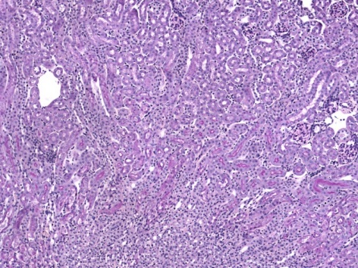
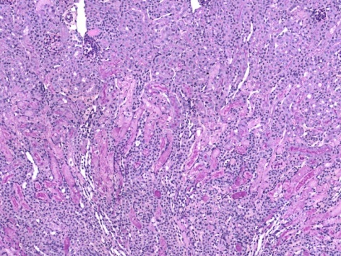
A
B
SHAM (6 h)
IR (6 h)
SHAM (24 h)
IR (24 h)
1.3
*
*
1.2
1.1
1.0
Sham
IR 6 h
IR 24 h
0.9
0.8
0.7
*
Plasma creatinine (mg/dl)
H&E
100μm
0.6
0.5
0.4
0.3
0.2
0.1
PAS
0
Notes:
Clinically, ischemia is a le
AKI refers to a complex disorder that comprises multiple causative factors and occurs in a variety of settings with varied clinical manifestations that range from a minimal but sustained elevation in serum creatinine to anuric renal failure. ading cause of AKI, which may result from a variety of conditions, such as decreased cardiac output, renal vascular occlusion or obstruction, and kidney transplantation.

Slide 14
3.0
PE O-40:5
780.6_639.6
GD2 32:2;2
(LCB 18:2;2-2H₂O,
LCB 18:1;3-3H₂O)
809.7_262.3
-log₁₀p
2.5
PC O-38:1
802.7_184.1
2.0
PE O-40:4
782.6_641.6
PE O-42:3
812.7_198.1
1.5
GT2 26:0;2
(LCB 18:0;2-H2O)
900.8_284.3
1.0
0.5
-15
-10
-5
0
5
10
15
Log₂FC (6 hours)

Slide 15
SWATH-MS on renal lipids following ischemia/reperfusion (IR)-induced kidney injury
3.0
12
-log₁₀p
-log₁₀p
2.5
PC O-38:1
802.7_184.1
PE O-42:3
812.7_198.1
10
GD2 32:2;2
(LCB 18:2;2-2H₂O,
LCB 18:1;3-3H₂O)
809.7_262.3
PE O-40:4
782.6_641.6
2.0
8
PC O-38:1
802.7_184.1
PE O-42:3
812.7_198.1
1.5
6
1.0
4
2
0.5
2
-15
-10
-5
0
5
10
15
-15
-10
-5
0
5
10
15
Log₂FC (6 hours)
Log₂FC (24 hours)
Intensity >10

Slide 16
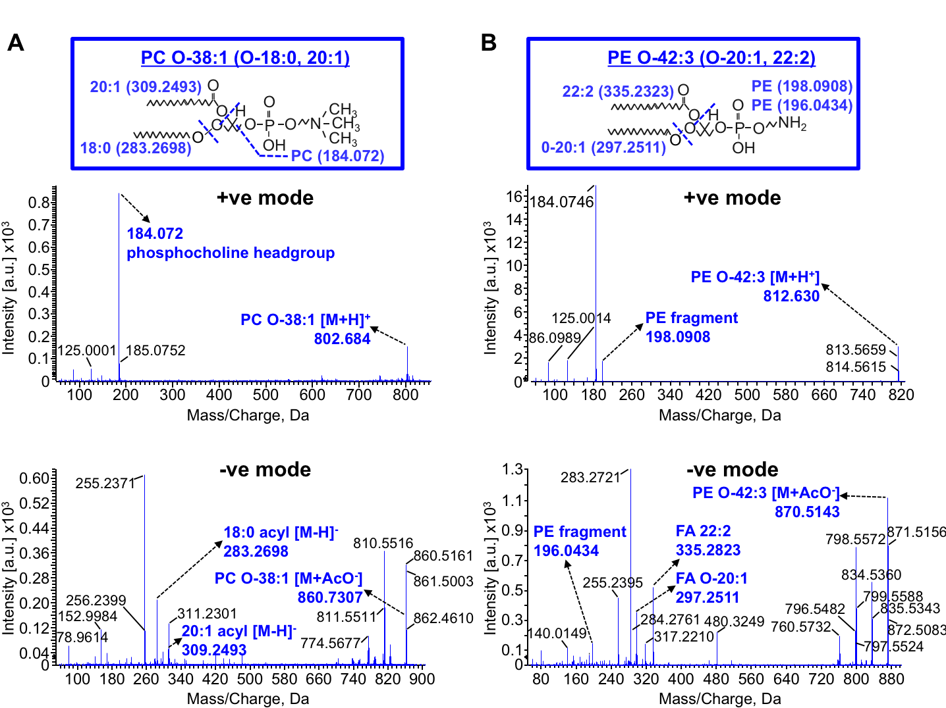

Slide 17
Figure 4
A
20
250
160
140
18
200
120
16
14
150
100
12
PC O-38:1 intensity (au)
PE O-42:3 intensity (au)
PE O-40:4 intensity (au)
r=0.730
p=0.0062
80
r=0.717
p=0.00872
10
r=0.771
p=0.0023
100
60
8
Sham (6h)
40
6
50
IR (6h)
4
20
2
0
0
2
4
6
8
10
12
0
0
2
4
6
8
10
12
0
0
2
4
6
8
10
12
Plasma creatinine (IR 0.5/6h) (mg/dl)
Plasma creatinine (IR 0.5/6h) (mg/dl)
Plasma creatinine (IR 0.5/6h) (mg/dl)
B
20
25
0.30
30
18
Sham (6h)
16
r=0.724
p=0.0062
20
0.25
IR (6h)
25
14
0.20
20
12
15
r=0.532
p=0.0748 (ns)
PE O-40:5 intensity (au)
GD2 43:2;2 intensity (au)
15
10
0.15
Lipid (ng/mg kidney)
8
10
6
0.10
10
Sham (6h)
4
5
IR (6h)
0.05
5
2
0
0
0
2
4
6
8
10
12
0
0
AA
LA
0
2
4
6
8
10
12
5-HETE
9-HODE
Plasma creatinine (IR 0.5/6h) (mg/dl)
Plasma creatinine (IR 0.5/6h) (mg/dl)
13-HODE
12-HETE
15-HETE

Slide 18
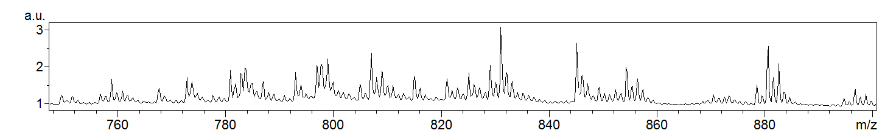
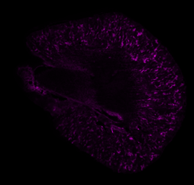
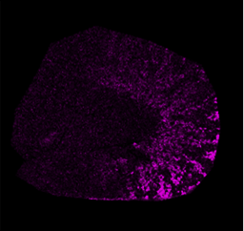
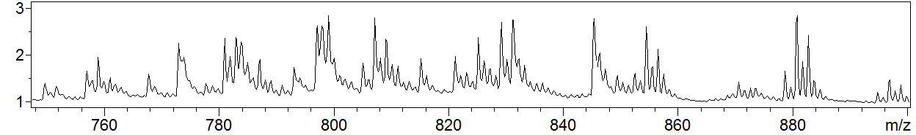
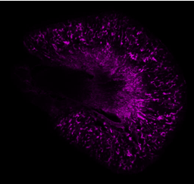
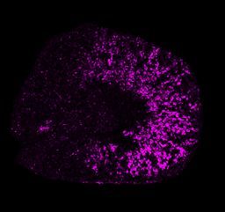
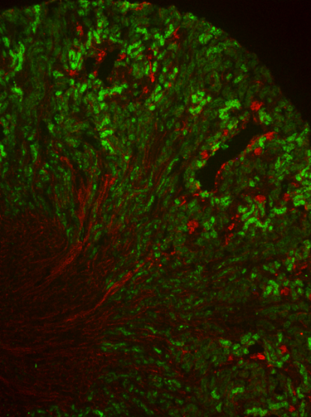
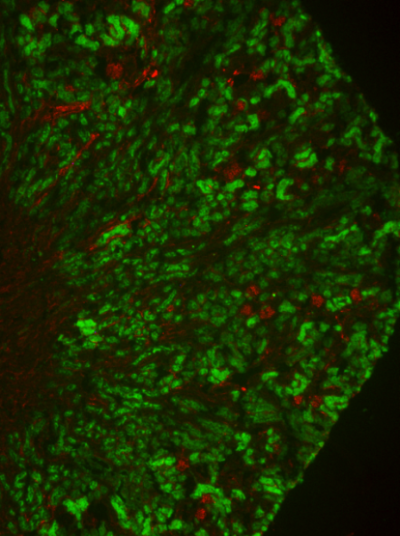
PC O-18:0/20:1 imaging in sham and IR kidneys
802.7m/z [M+H⁺]
824.7m/z [M+Na⁺]
Sham (6 h)
Sham (6 h)
1mm
IR (6 h)
763.583
2.5
Intensity
2.0
184.1 m/z phosphocholine
IR (6 h)
1.5
824.678
Intensity [a.u.] (x10⁴)
1.0
162.214
0.5
86.114
645.387
0.0
100
200
300
400
500
600
700
800
900
802.7m/z [M+H⁺]
802.7m/z [M+H⁺]
Mass/Charge (m/z), Da
Sham (6 h)
IR (6 h)
Sham (6 h)
1mm
IR (6 h)
Lotus Lectin
PECAM-1
Lotus Lectin
PECAM-1
824.7m/z [M+Na⁺]
824.7m/z [M+Na⁺]

Slide 19
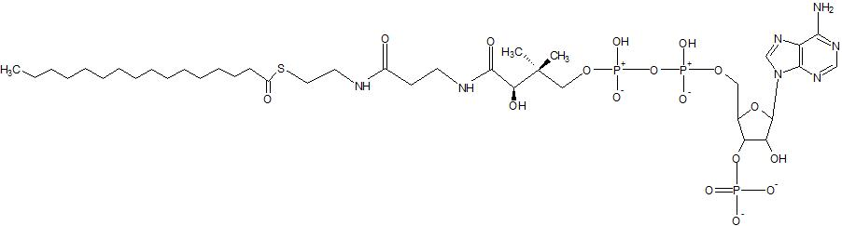
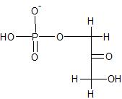
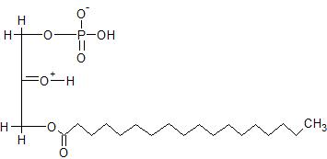


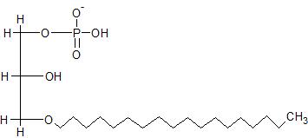
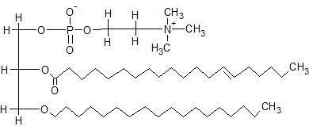
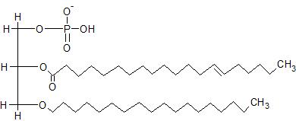
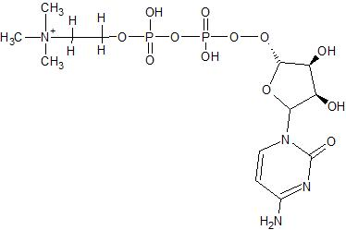
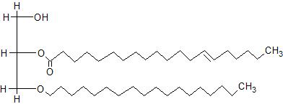
Biosynthesis of Ether PC in Animal Tissue
Fatty acyl coenzyme A
From the AOCS Lipid Library
DHAP acyltransferase
+
Dihydroxyacetone phosphate (DHAP)
1-acyl-DHAP
18:0 chain alcohol
1-acyl DHAP synthase
1-acyl/alkyl DHAP reductase
Choline kinase
Phosphocholine
Choline
…to plasmalogens via 1-alkyl-2-acyl-sn-glycerophosphocholine desaturase, methyltransferases and base-exchange enzymes.
1-O-alkyl-glycerol-3-phosphate
CTP:phosphocholine cytidylyltransferase
1-alkyl-sn-glycerophosphate acyltransferase
CDP-choline transferase
1-alkyl-2-acyl-glycero-3-phosphocholine
1-O-alkyl-2-acyl-glycero-3-phosphate
+
1-alkyl-2-acyl glycerophosphate phosphohydrolase
1-alkyl-2-acyl-glycerol
Rate-limiting peroxisomal enzymes most abundant in kidney proximal tubules.

Slide 20
Summary
MALDI-TOF imaging mass spectrometry is a very powerful technique to determine the distribution of small molecules within a tissue
  In this study it was applied to lipid species in the damaged kidney
  It has the potential for application to many other tissues such as brain, heart, liver, lung and the visual system

Slide 21


Acknowledgments
owship Program
Sangeetha Rao

